Slide 1
ADAPTIVE MONITORING FOR EARLY STAGE RANSOMWARE DETECTION VIA BEHAVIOUR AND NETWORK TRAFFIC ANALYSIS

Slide 2
Contents of the presentation
Implementation
1. Data Description
2. EDA Explanation
3. Preprocessing steps
Model Implementation
1. Algorithm Definition
2. working Process
3. Results from Algorithm
Performance comparison
Output Screen
Future Scope
Conclusion
Reference
Project Description
Problem Statement
Objective
Scope
Literature Survey
Significant
Proposed System
Architecture
Resource Requirements
Umls
Research Gap analysis
Implementation

Slide 3
Project Description
The rise of ransomware attacks has underscored the urgent need for advanced detection mechanisms to identify threats in their early stages. Traditional signature-based detection methods often fail to recognize new or evolving ransomware strains, making adaptive and proactive monitoring critical. This paper proposes a robust framework for early-stage ransomware detection through adaptive monitoring, leveraging both behavioral analysis and network traffic examination. The approach combines machine learning algorithms with real-time monitoring of system behaviors and network patterns to detect anomalies indicative of ransomware activity. By analyzing file access patterns, encryption processes, and unauthorized data movements alongside unusual network traffic such as large data transfers or encrypted communication, the proposed system identifies early indicators of potential ransomware activity. Adaptive models are trained to evolve with new data, enhancing the system’s resilience against novel ransomware tactics and minimizing false positives.The proposed framework integrates a multi-layered approach, ensuring comprehensive monitoring and early alerts, which are crucial for mitigating damage and preventing the spread of ransomware across networks. Experimental results demonstrate that this adaptive monitoring approach can detect ransomware at early stages, reducing response time and enabling preemptive actions, such as isolating affected systems, to safeguard organizational assets
Keywords: Ransomware Detection,Adaptive Monitoring,Behavioral Analysis,Network Traffic Analysis,Early-Stage Detection,Machine Learning,Cybersecurity,Anomaly Detection,Real-Time Monitoring,Malware Prevention

Slide 4
Problem Statement
The rapidly evolving nature of ransomware presents significant challenges to existing cybersecurity mechanisms. Traditional signature-based detection methods often fail to recognize novel ransomware strains or zero-day attacks, leaving systems vulnerable to sophisticated threats. Furthermore, many current detection approaches lack the ability to identify early indicators of ransomware activity, such as suspicious file access patterns, encryption processes, and unauthorized data transfers, leading to delayed responses and increased damage. The absence of integrated behavioral and network traffic analysis exacerbates this issue, as organizations struggle to identify and mitigate ransomware before it causes irreparable harm. As ransomware techniques continue to evolve, attackers exploit these limitations to bypass detection systems and execute their malicious operations. The lack of adaptive monitoring mechanisms compounds the problem, as static models fail to adapt to new attack vectors. Therefore, there is an urgent need for a comprehensive framework that integrates machine learning-driven behavioral analysis and network traffic examination to detect anomalies in real-time, enabling proactive and effective mitigation of ransomware threats.

Slide 5
Objective of the Project
The primary objective of this project is to design and develop an adaptive monitoring framework for the early detection of ransomware using behavioral and network traffic analysis. This framework aims to identify ransomware activity in its nascent stages by analyzing system behaviors, such as file access patterns, encryption processes, and unauthorized data movements, alongside unusual network traffic indicators, including large data transfers and encrypted communication. By leveraging machine learning algorithms, the system will detect anomalies indicative of ransomware, enabling rapid response and mitigation. A key focus is on developing adaptive models that evolve with new data, ensuring resilience against emerging ransomware tactics. The framework will also minimize false positives, enhancing detection accuracy and operational efficiency. Additionally, the project aims to integrate a multi-layered approach, combining real-time monitoring, anomaly detection, and preemptive action mechanisms, such as isolating affected systems. This comprehensive framework will provide organizations with a robust defense mechanism, reducing response time, mitigating damage, and safeguarding critical assets from ransomware attacks.

Slide 6
Scope
This project encompasses the development of a comprehensive ransomware detection system that combines behavioral analysis and network traffic monitoring to identify threats in their early stages. The scope includes leveraging machine learning algorithms for real-time anomaly detection, focusing on features such as file access patterns, encryption processes, unauthorized data movements, and unusual network traffic. The adaptive nature of the framework ensures it evolves with emerging ransomware techniques, providing robust protection against novel threats. The system will be designed for scalability, allowing deployment in diverse environments, including corporate networks, government infrastructures, and cloud-based systems. Furthermore, the project aims to minimize false positives and enhance detection accuracy through extensive model training and validation using real-world datasets. The implementation will include mechanisms for preemptive actions, such as system isolation and alert generation, to mitigate potential damage. By addressing the limitations of traditional signature-based detection systems, this project aims to contribute to the development of intelligent cybersecurity solutions that enhance organizational resilience against ransomware attacks.

Slide 7
Motivation
Ransomware has emerged as one of the most pervasive and damaging forms of cyber threats, targeting individuals, businesses, and governments alike. Traditional detection systems, often reliant on signature-based methods, are ineffective against rapidly evolving ransomware strains and zero-day attacks. The financial and reputational damage caused by these attacks can be catastrophic, ranging from operational disruptions to significant data loss and ransom payments. This alarming rise underscores the need for more adaptive, intelligent, and proactive monitoring systems capable of identifying threats in their early stages. Early detection can prevent the encryption of critical data and the lateral spread of ransomware across organizational networks, significantly mitigating potential damage. Moreover, with the increasing complexity and sophistication of ransomware techniques, such as fileless attacks and encryption obfuscation, organizations require advanced solutions that combine behavioral and network traffic analysis to detect anomalies indicative of malicious activity. This study aims to address the pressing need for an adaptive ransomware detection framework that evolves with emerging threats, ensuring robust protection for organizational assets and fostering resilience against cyberattacks.

Slide 8
Literature Survey
S.NO | YEAR | AUTHORS | TITLE | OUT COMES
1 | 2024 | G. Li, S. Wang, Y. Chen, J. Zhou, and Q. Zhao | A Hybrid Framework for Ransomware Detection Using Deep Learning and Monte Carlo Tree Search | This paper proposes a hybrid framework combining deep learning techniques and Monte Carlo Tree Search for ransomware detection.
2 | 2024 | S. Wasoye, M. Stevens, C. Morgan, D. Hughes, and J. Walker | Ransomware Classification Using BTLS Algorithm and Machine Learning Approaches | This study explores the use of the BTLS algorithm in conjunction with machine learning models for ransomware classification.

Slide 9
S.NO | YEAR | AUTHORS | TITLE | OUT COMES
3 | 2024 | J. Kirkland, R. Stoddard, B. Antonov, N. Dragomirov, and A. Belmonte | Automated Detection of Crypto Ransomware Using Machine Learning and File Entropy Analysis | This research focuses on the automated detection of crypto ransomware through machine learning models and file entropy analysis.
4 | 2024 | M. Ozturk, A. Demir, Z. Arslan, and O. Caliskan | Dynamic Behavioural Analysis of Privacy-Breaching and Data Theft Ransomware | This paper presents a dynamic behavioral analysis framework targeting ransomware involved in privacy breaches and data theft.

Slide 10
S.NO | YEAR | AUTHORS | TITLE | OUT COMES
5 | 2023 | T. Kumamoto, Y. Yoshida, and H. Fujima | Evaluating Large Language Models in Ransomware Negotiation: A Comparative Analysis of ChatGPT and Claude | This study examines the application of large language models like ChatGPT and Claude in ransomware negotiations

Slide 11
Significant
The increasing frequency and sophistication of ransomware attacks highlight the limitations of traditional detection systems, which often rely on signature-based methods that struggle to identify emerging threats. This paper presents an innovative framework aimed at overcoming these limitations by focusing on adaptive monitoring for early-stage ransomware detection. The approach combines two key components: behavioral analysis and network traffic examination. By monitoring system behaviors—such as file access patterns, encryption activities, and unauthorized data movements—alongside network traffic anomalies like large data transfers or encrypted communications, the framework is able to identify early indicators of ransomware activity.
One of the key strengths of this method is its adaptive nature, which allows the system to evolve based on new data. This continuous learning process enhances the detection capabilities of the system, making it resilient to new and evolving ransomware tactics, while minimizing the occurrence of false positives. Through the integration of machine learning algorithms and real-time monitoring, the framework offers a comprehensive multi-layered approach to threat detection.
Experimental results demonstrate that this adaptive monitoring system significantly reduces the response time for identifying ransomware and enables proactive measures, such as isolating infected systems to limit the spread of the attack. This not only minimizes damage but also contributes to an overall more robust cybersecurity posture for organizations. The findings underscore the importance of combining behavioral and network traffic analysis in developing advanced defenses against increasingly sophisticated ransomware threats.

Slide 12
Proposed System
The proposed system leverages adaptive monitoring for early-stage ransomware detection by integrating behavioral analysis and network traffic analysis. Utilizing machine learningalgorithms, the system dynamically identifies patterns in file access, encryption activities, and data movement that deviate from standard operations, flagging suspicious behaviors indicative of ransomware. Concurrently, the system monitors network traffic for anomalies such as unauthorized data transfers, abnormal encrypted connections, and excessive data requests, which may signal early ransomware activities.A multi-layered approach combines these analyses, creating a robust defense mechanism that captures the complexity of ransomware behavior. The machine learning models continuously adapt by learning from new data, enhancing detection accuracy and ensuring resilience against evolving ransomware tactics. Upon detecting suspicious activity, the system triggers automated responses, such as alerting administrators, isolating potentially affected endpoints, or restricting network access, to minimize damage.The system’s architecture ensures low latency, enabling real-time monitoring and early alerts to stop ransomware in its initial stages. Experimental evaluations indicate high accuracy and low false positive rates, underscoring its potential to significantly improve organizational resilience against ransomware.

Slide 13
Advantages
· Early Detection: The system identifies ransomware at an early stage by detecting suspicious behavioral and network anomalies, allowing preemptive actions before significant damage occurs.
· Adaptive Learning: By using machine learning algorithms that continuously learn from new data, the system adapts to emerging ransomware variants, making it resilient against new and evolving threats.
· Real-Time Monitoring: The low-latency design enables real-time monitoring, providing instant alerts to administrators, which is crucial for rapid response and mitigation.
· Comprehensive Analysis: By combining behavioral and network traffic analysis, the system offers a multi-layered approach, enhancing accuracy and reducing the likelihood of missed detections.
· Automated Response: The system can automatically isolate affected endpoints or restrict network access, which minimizes the spread of ransomware across the network and reduces manual intervention.
· Reduced False Positives: Adaptive learning and multi-factor analysis help reduce false positives, ensuring that only genuine threats are flagged, which improves system efficiency and user trust.
· Enhanced Organizational Security: With its proactive and adaptive approach, the system significantly enhances an organization's resilience against ransomware, protecting critical data and minimizing financial and operational risks.

Slide 14
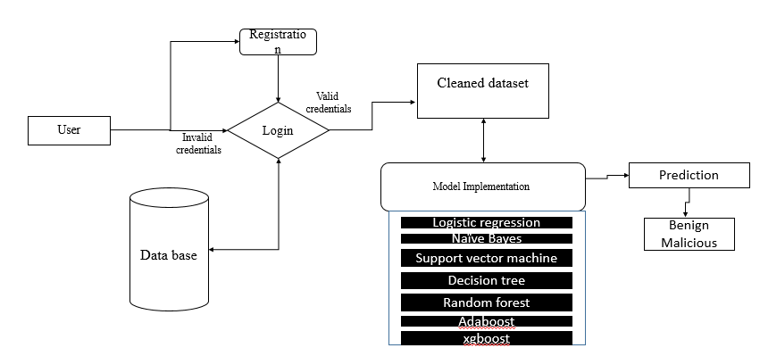
Architecture

Slide 15
Resource Requirements
01
Hardware
(Processor: I5/Intel Processor, RAM: 8GB (min), Hard Disk: 128 GB, Key Board: Standard Windows Keyboard, Mouse: Two or Three Button Mouse)
Resources
02
Software
(Operating System: Windows 10, Programming Language: Python 3.10.8, IDE: VS Code)
Packages/Libraries
03
(Streamlit, Sklearn, Transformers, Tensorflow, Pandas, Seaborn, Speech Recognition

Slide 16
UML DIAGRAMS
Use Case Diagram:
1) A use case diagram in the Unified Modeling Language (UML) is a type of behavioral diagram defined by and created from a Use-case analysis.
2) Its purpose is to present a graphical overview of the functionality provided by a system in terms of actors, their goals (represented as use cases), and any dependencies between those use cases.
3) The main purpose of a use case diagram is to show what system functions are performed for which actor. Roles of the actors in the system can be depicted.

Slide 17
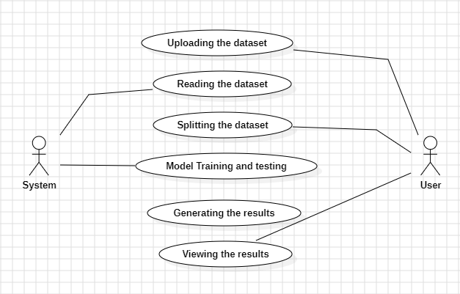
Figure: Use Case Diagram

Slide 18
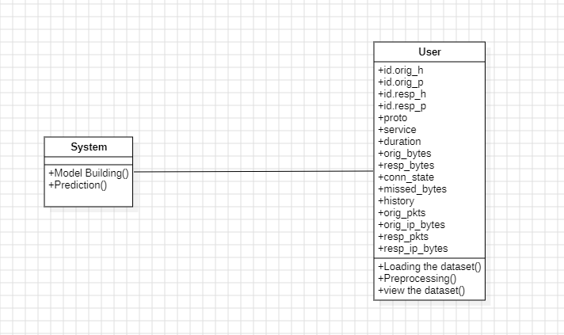
Class Diagram:
In software engineering, a class diagram in the Unified Modeling Language (UML) is a type of static structure diagram that describes the structure of a system by showing the system's classes, their attributes, operations (or methods), and the relationships among the classes. It explains which class contains information

Slide 19
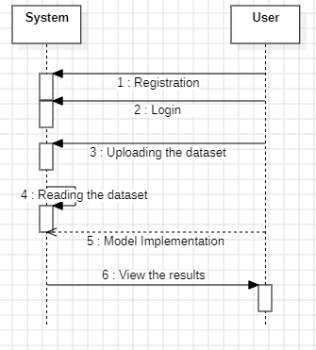
Sequence Diagram:
A sequence diagram in Unified Modeling Language (UML) is a kind of interaction diagram that shows how processes operate with one another and in what order.
It is a construct of a Message Sequence Chart. Sequence diagrams are sometimes called event diagrams, event scenarios, and timing diagrams
Figure: Sequence diagram

Slide 20
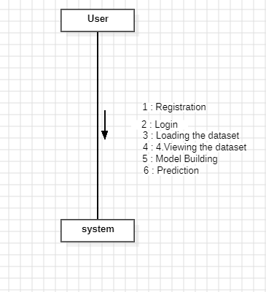
Collaboration Diagram:
In collaboration diagram the method call sequence is indicated by some numbering technique as shown below. The number indicates how the methods are called one after another. We have taken the same order management system to describe the collaboration diagram. The method calls are similar to that of a sequence diagram. But the difference is that the sequence diagram does not describe the object organization whereas the collaboration diagram shows the object organization.
Figure: Collaboration diagram

Slide 21

Deployment Diagram
Deployment diagram represents the deployment view of a system. It is related to the component diagram. Because the components are deployed using the deployment diagrams. A deployment diagram consists of nodes. Nodes are nothing but physical hardware’s used to deploy the application.
Figure: Deployment diagram

Slide 22
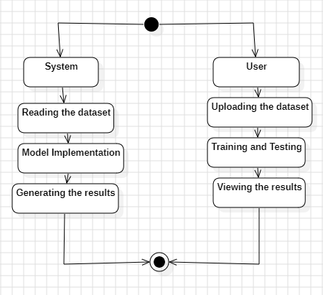
Activity Diagram:
Activity diagrams are graphical representations of workflows of stepwise activities and actions with support for choice, iteration and concurrency. In the Unified Modelling Language, activity diagrams can be used to describe the business and operational step-by-step workflows of components in a system. An activity diagram shows the overall flow of control.
Figure: Activity diagram

Slide 23

Component Diagram:
A component diagram, also known as a UML component diagram, describes the organization and wiring of the physical components in a system. Component diagrams are often drawn to help model implementation details and double-check that every aspect of the system's required function is covered by planned development.
Figure: Component diagram

Slide 24
ER Diagram:
An Entity–relationship model (ER model) describes the structure of a database with the help of a diagram, which is known as Entity Relationship Diagram (ER Diagram). An ER model is a design or blueprint of a database that can later be implemented as a database. The main components of E-R model are: entity set and relationship set.
An ER diagram shows the relationship among entity sets. An entity set is a group of similar entities and these entities can have attributes. In terms of DBMS, an entity is a table or attribute of a table in database, so by showing relationship among tables and their attributes, ER diagram shows the complete logical structure of a database. Let’s have a look at a simple ER diagram to understand this concept.

Slide 25
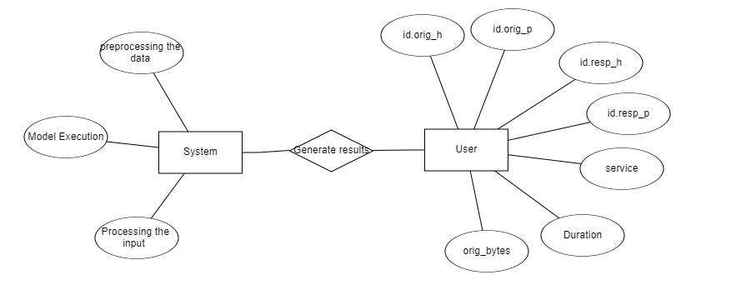
Figure: ER diagram

Slide 26
DFD Diagram:
A Data Flow Diagram (DFD) is a traditional way to visualize the information flows within a system. A neat and clear DFD can depict a good amount of the system requirements graphically. It can be manual, automated, or a combination of both. It shows how information enters and leaves the system, what changes the information and where information is stored. The purpose of a DFD is to show the scope and boundaries of a system as a whole. It may be used as a communications tool between a systems analyst and any person who plays a part in the system that acts as the starting point for redesigning a system.

Slide 27
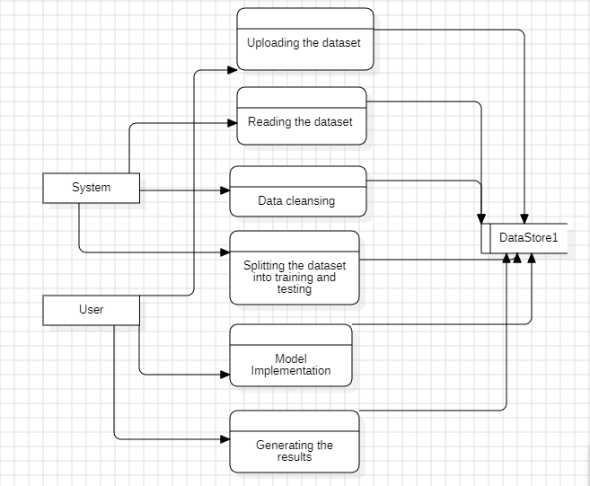
FigureLevel-1 diagram

Slide 28
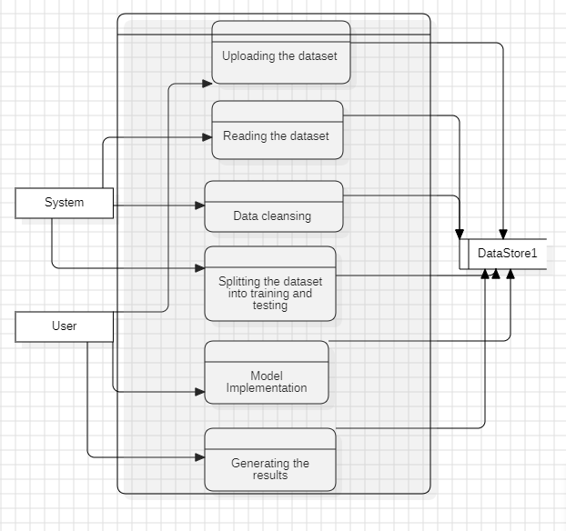
Figure:Level-2 diagram

Slide 29
Research Gap analysis
Despite the significant advancements in cybersecurity, traditional ransomware detection methods, primarily signature-based approaches, face limitations in identifying new and evolving ransomware strains. These methods are increasingly ineffective against sophisticated attacks that use polymorphic and metamorphic techniques, rendering the detection system obsolete for novel threats. Furthermore, current systems often fail to detect ransomware activity in its early stages, missing critical warning signs that could prevent the spread of attacks. This gap is compounded by the lack of integration between behavioral analysis and network traffic monitoring, which could provide a more comprehensive view of ransomware activity. Most existing solutions focus on individual aspects such as file encryption or system behaviors, without considering the broader context of network traffic anomalies that are often key indicators of ransomware presence. Moreover, there is a lack of adaptive models capable of evolving with new data, which limits the ability to detect emerging ransomware tactics and reduces the accuracy of existing systems. Thus, there is a clear need for an integrated, adaptive monitoring framework that combines real-time system behavior analysis and network traffic analysis, offering a dynamic response to ransomware threats and enhancing early-stage detection capabilities.

Slide 30
MODULES
System
User
1. System:
1.1 Store Dataset:
The System stores the dataset given by the user.
1.2 Model Training:
The system takes the data from the user and fed that data to the selected model.
1.3 Model Predictions:
The system takes the data given by the user and predict the output based on the given data.
2. User:
2.1.Registration: User can register his values on the website and also validations are applied

Slide 31
2.2 Login:
Username/Email Field: Checks for valid email formats or existing usernames.
Password Field: Ensures the password meets security requirements (e.g., minimum length, complexity).
Validation Messages: Provides immediate feedback if the input is incorrect or if the account details do not match.
2.3.Viewing the dataset :
User can able to view the dataset
2.4.Model selection:
User can selects the accuracy of a model and view the accuracy of that particular model
2.5.Prediction:
User can predict based on the if the person is suffering from stress or not stress.

Slide 32
Implementation
Data Analysis
Model Implementation
01
Data Description
04
Algorithm Definition
02
EDA Explanation
05
Working Process
03
Preprocessing steps
06
Results from Algorithm

Slide 33
Data Description
dataset:https://www.kaggle.com/datasets/cloudymts/ransomeware-dataset
id.orig_h: This represents the originating host's IP address. It is the address of the source machine from where the network packet originates.
id.orig_p: This represents the originating port number. It is the port used on the source machine for sending the data packet.
id.resp_h: This is the responding host's IP address. It represents the destination IP address or the machine that receives the data packet.
id.resp_p: This represents the responding port number. It is the port used on the destination machine (the responding side) to receive the data packet.
proto: This refers to the protocol used for the communication. Examples include TCP (Transmission Control Protocol), UDP (User Datagram Protocol), or ICMP (Internet Control Message Protocol).
service: This refers to the network service used by the communication. It could include common services like HTTP (for web traffic), FTP (File Transfer Protocol), SMTP (Simple Mail Transfer Protocol), etc.
duration: This indicates the total duration of the connection or session, typically measured in seconds. It represents how long the network connection lasted.
orig_bytes: This is the number of bytes sent from the originating host. It represents the data volume sent by the source machine.
resp_bytes: This is the number of bytes received by the responding host. It represents the data volume sent back from the destination machine to the source.
conn_state: This indicates the current state of the connection. Common states include "S0" (no reply), "SF" (successful connection), "REJ" (rejected connection), etc. It helps in identifying the status of the connection.

Slide 34
missed_bytes: This represents the number of bytes that were missed in the communication, typically used in cases where some packets might have been lost during the transfer.
history: This field might contain a record of the session or connection's history, such as whether the session was established previously or any anomalies encountered during the connection.
orig_pkts: The number of packets sent from the originating host during the connection. It helps in analyzing traffic flow.
orig_ip_bytes: This represents the total number of IP-level bytes sent from the originating host, which includes the data and any additional headers or overhead.
resp_pkts: The number of packets received by the responding host during the connection.
resp_ip_bytes: This represents the total number of IP-level bytes received by the responding host.
label: The label column generally indicates the type of traffic or the nature of the communication. It could be "normal" for typical network traffic or a specific label indicating suspicious or malicious activity (e.g., "attack" or "anomaly"). It helps in classifying the traffic and detecting intrusions or other irregularities.

Slide 35
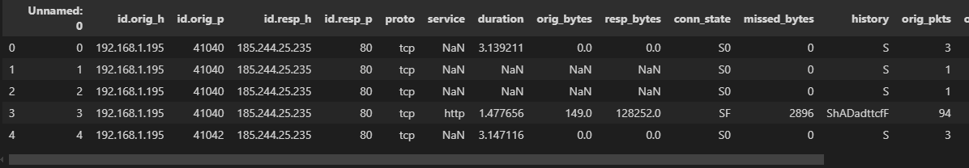
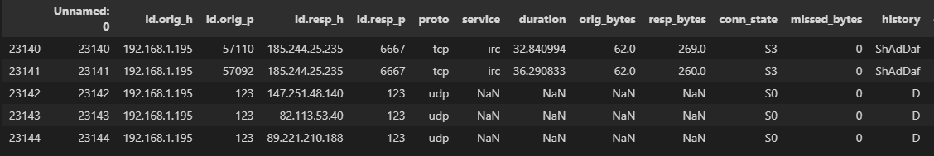
Exploratory Data Analysis
This the top 5 rows of the dataset here we see the how was the dataset values.
This the Bottom 5 rows of the dataset here we see the how was the dataset values.

Slide 36
Pre-processing steps
In the proposed framework for early-stage ransomware detection, the pre-processing steps are essential for preparing the raw data for machine learning models and ensuring the accuracy of anomaly detection. The first step involves data collection, where system behavior data and network traffic logs are gathered in real-time from the target environment. This data includes file access patterns, encryption activities, unauthorized data transfers, and network traffic such as unusually large data uploads or encrypted communication. Next, the data cleaning process is performed to eliminate any noise, inconsistencies, or irrelevant information. This involves removing incomplete or corrupted logs, handling missing values, and ensuring that the collected data is relevant to ransomware detection. After cleaning, the data undergoes feature extraction, where critical attributes such as the frequency of file accesses, the size of transferred files, and the type of network traffic are extracted to form a structured dataset. These features are normalized or standardized to ensure consistency and scalability. In parallel, the data labeling step assigns binary labels to the data—indicating whether the behavior or traffic corresponds to normal activity or ransomware activity—using historical attack data and expert domain knowledge. The final pre-processing step is data transformation, where the data is formatted into suitable structures for the machine learning algorithms, such as time-series or event-based representations, ensuring it is ready for model training. Together, these pre-processing steps are crucial for ensuring that the adaptive monitoring system can effectively detect anomalies and provide timely, accurate alerts for early-stage ransomware detection.

Slide 37
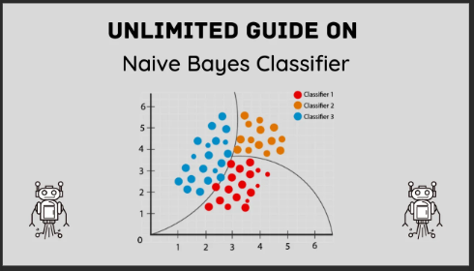
Algorithm Definition
Naive Bayes:
Definition: Naive Bayes is a probabilistic classifier based on Bayes' Theorem, which applies the "naive" assumption that features are independent of each other. It is particularly effective for large datasets and text classification problems, such as spam detection.
.

Slide 38

Internal Working: Naive Bayes calculates the posterior probability for each class by multiplying the prior probability of the class with the likelihood of the observed features, assuming independence between them. The class with the highest posterior probability is selected as the predicted class. It uses Bayes’ Theorem, which is mathematically represented as:
where P(C∣X)P(C | X)P(C∣X) is the posterior probability of class CCC given features XXX, P(X∣C)P(X | C)P(X∣C) is the likelihood of features given class, and P(C)P(C)P(C) is the prior probability of the class.
Key Characteristics:
Simple and fast probabilistic classifier.
Assumes feature independence, which is often unrealistic but works well in many applications.
Well-suited for text classification and large datasets.

Slide 39
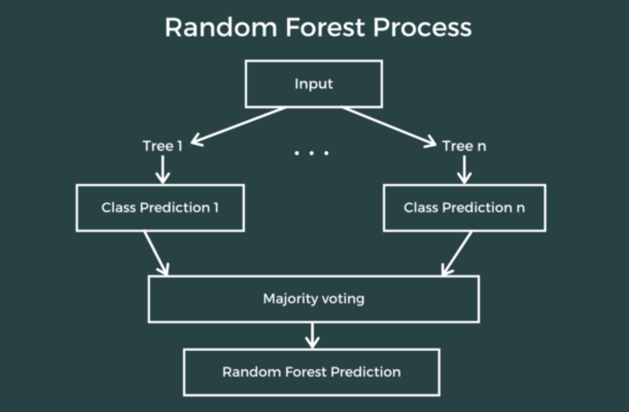
Random Forest Classifier
Definition: Random Forest is an ensemble learning algorithm that combines multiple decision trees to improve the accuracy and robustness of predictions. Each tree in the forest is built using a subset of the data, and the final prediction is based on the majority vote or average from all the trees. This method helps in reducing overfitting, which is a common problem in individual decision trees.

Slide 40
Internal Working: Random Forest works by generating multiple decision trees using bootstrapped samples from the training data. During the construction of each tree, at each node, a random subset of features is selected for splitting, which helps to avoid correlation between the trees. Once all the trees are built, each tree gives a classification or regression output. For classification, the class with the majority vote is selected, while for regression, the mean prediction from all trees is chosen.
Key Characteristics:
Ensemble method combining several weak classifiers (decision trees) into a strong classifier.
Reduces overfitting by averaging predictions from multiple trees.
Uses bootstrapped samples and random feature selection at each node.

Slide 41
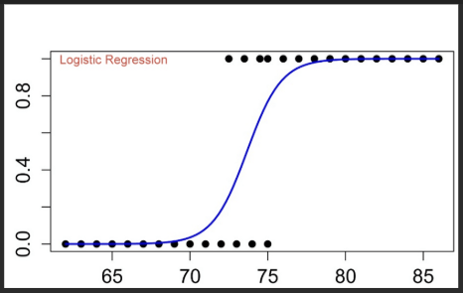
Logistic Regression
Definition: Logistic Regression is a statistical model used for binary classification problems. It predicts the probability of an instance belonging to a particular class using the logistic function (also known as the sigmoid function). Despite its name, logistic regression is used for classification, not regression.
.

Slide 42
Internal Working: Logistic Regression computes a weighted sum of input features and passes the result through the sigmoid function to output a probability between 0 and 1. The model is trained using optimization techniques like gradient descent to minimize the binary cross-entropy loss, which measures the difference between predicted probabilities and actual labels.
Key Characteristics:
Predicts binary outcomes (0 or 1) based on feature inputs.
Utilizes the sigmoid function to transform raw scores into probabilities.
Typically used for classification problems with two classes.

Slide 43
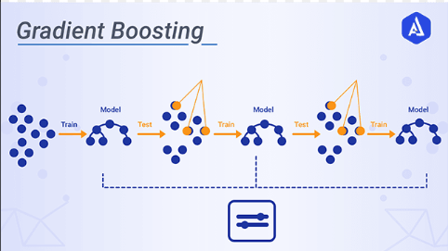
Gradient Boosting
Definition: Gradient Boosting is an ensemble technique that builds a series of weak models (usually decision trees) iteratively, where each new model corrects the errors made by the previous models. It is a powerful technique for both classification and regression tasks.

Slide 44
Internal Working: Gradient Boosting works by fitting a new model to the residual errors (the difference between predicted and actual values) of the previous model. It uses gradient descent to minimize the loss function by adjusting the weights of the model at each step. The models are added sequentially, and the predictions are made by aggregating the results of all the models.
Key Characteristics:
Sequential ensemble method where each model corrects the previous model’s errors.
Uses gradient descent to minimize the loss function.
Sensitive to noisy data and requires careful tuning to avoid overfitting.

Slide 45
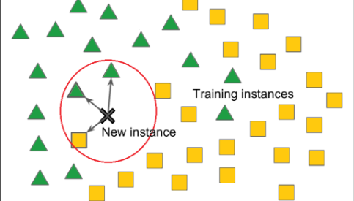
K-Nearest Neighbors (KNN)
Definition: K-Nearest Neighbors (KNN) is a non-parametric, instance-based learning algorithm used for classification and regression tasks. It classifies new data points based on the majority class of their k-nearest neighbors in the feature space.

Slide 46
Internal Working: For a given data point, KNN finds the 'k' closest data points in the training set (using distance metrics such as Euclidean distance). The new data point is assigned the class that is most common among its k-nearest neighbors (for classification) or the average of the neighbors' values (for regression). The model requires no training phase, as it simply memorizes the entire dataset.
Key Characteristics:
Instance-based learning: stores the entire training dataset.
No explicit training phase, making it easy to implement.
Sensitive to the choice of kkk and the distance metric used.

Slide 47
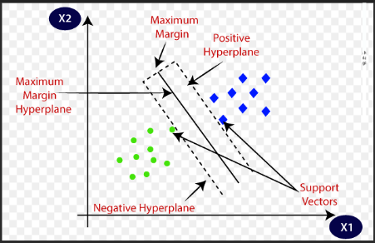
Support Vector Machine (SVM)
Definition: Support Vector Machine (SVM) is a supervised learning algorithm used primarily for classification tasks. It works by finding the hyperplane that best separates data points of different classes with the largest possible margin.

Slide 48
Internal Working: SVM creates a hyperplane (or decision boundary) in a high-dimensional space that maximizes the margin between different classes. It uses support vectors (the data points that are closest to the hyperplane) to determine this optimal boundary. SVM can also handle non-linearly separable data using the kernel trick, which transforms the data into higher-dimensional spaces.
Key Characteristics:
Finds the optimal hyperplane that separates classes with the largest margin.
Can use kernels for non-linear classification.
Effective for high-dimensional data and outperforms many other classifiers in terms of accuracy.

Slide 49
Comparision of Classification Models
Model | Training Accuracy
Naive Bayes | 0.98
Random Forest | 0.99
Logistic Regression | 0.99
Support Vector Machine | 0.51
Gradient Boosting | 0.99
K-Nearest Neighbors | 0.99

Slide 50

OUTPUT SCREEN SHOTS WITH DESCRIPTION.
Home Page:The HomePage serves as the landing page of your application. It provides an overview of the project's features, objectives, and benefits. Users can navigate to other sections of the application from this page.

Slide 51

AboutPage: The AboutPage offers detailed information about the project, including its purpose, goals, and the technology used. It provides background information on the problem being addressed and the methods employed.

Slide 52
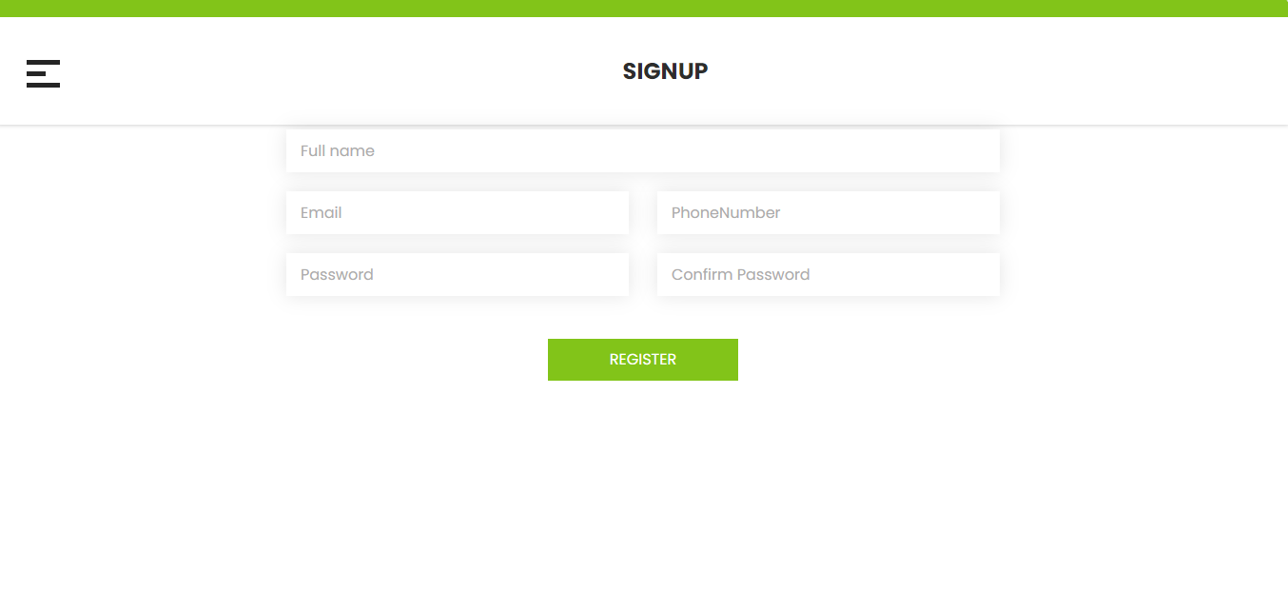
Registration Page: The Registration Page allows new users to create an account with the application. It typically includes fields for entering personal information such as name, email, password, and possibly other details like phone number or address. Users need to fill out this form to gain access to the application's features.

Slide 53

Login: The login page allows registered users to securely access the application. User have to provide register email and password.

Slide 54
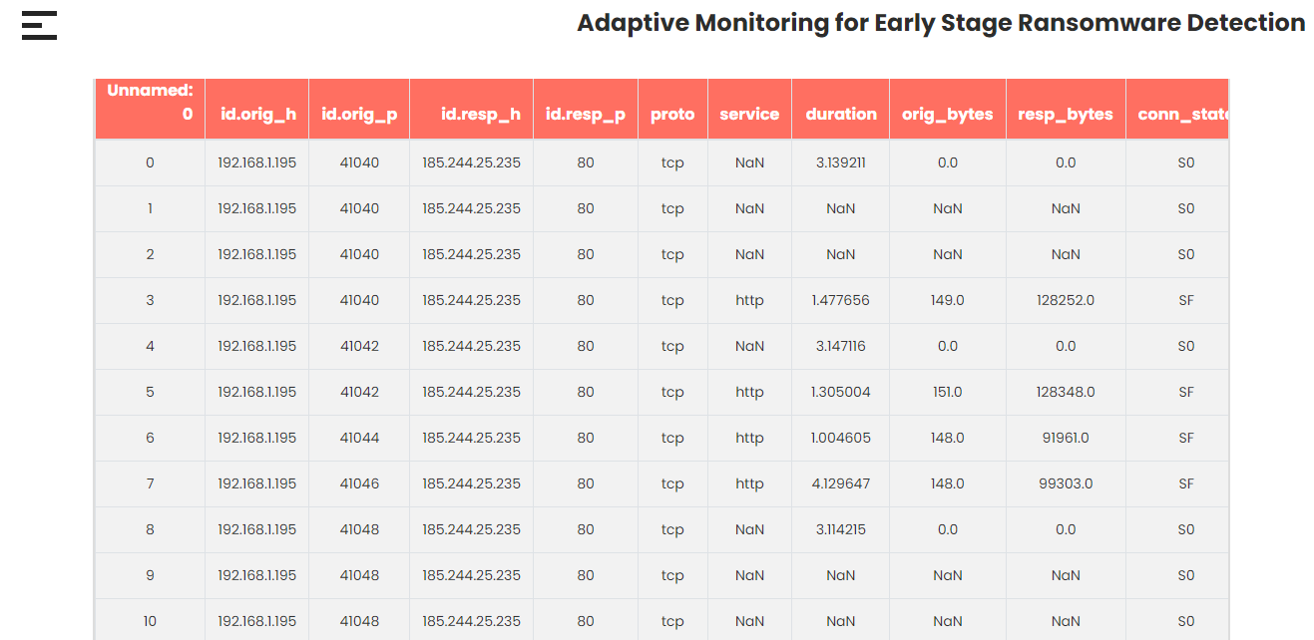
View: The view data page provides users with access to the data used for Bitcoin Pattern Analysis.

Slide 55
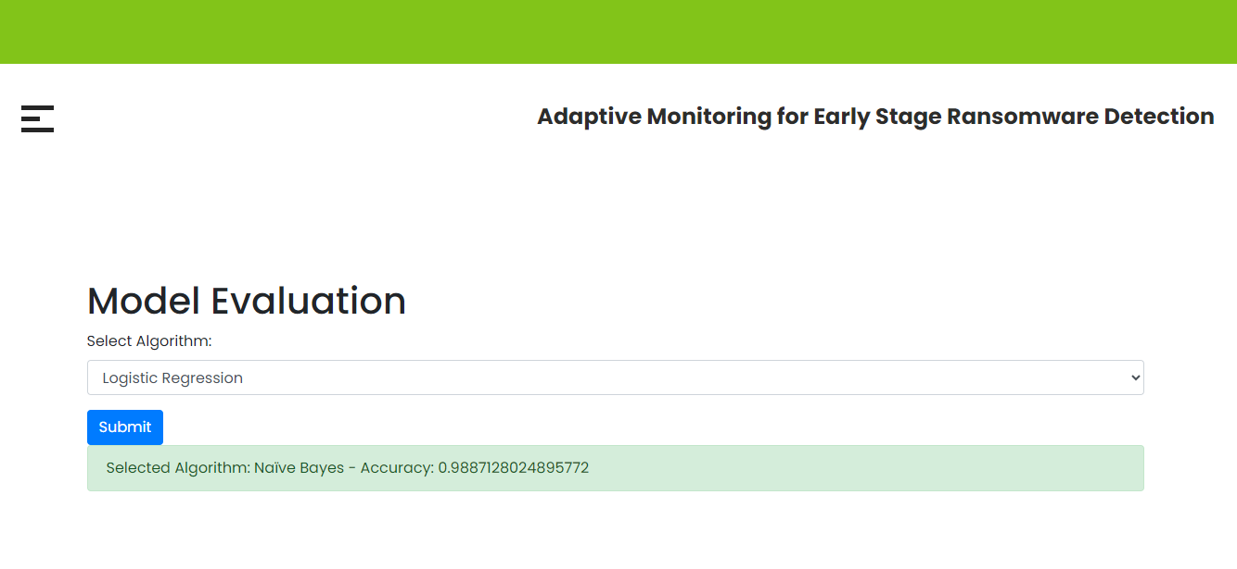
Model Selection: Here user have to select the model and and view the accuracy so that we know which algorithm is giving the highest accuracy.

Slide 56
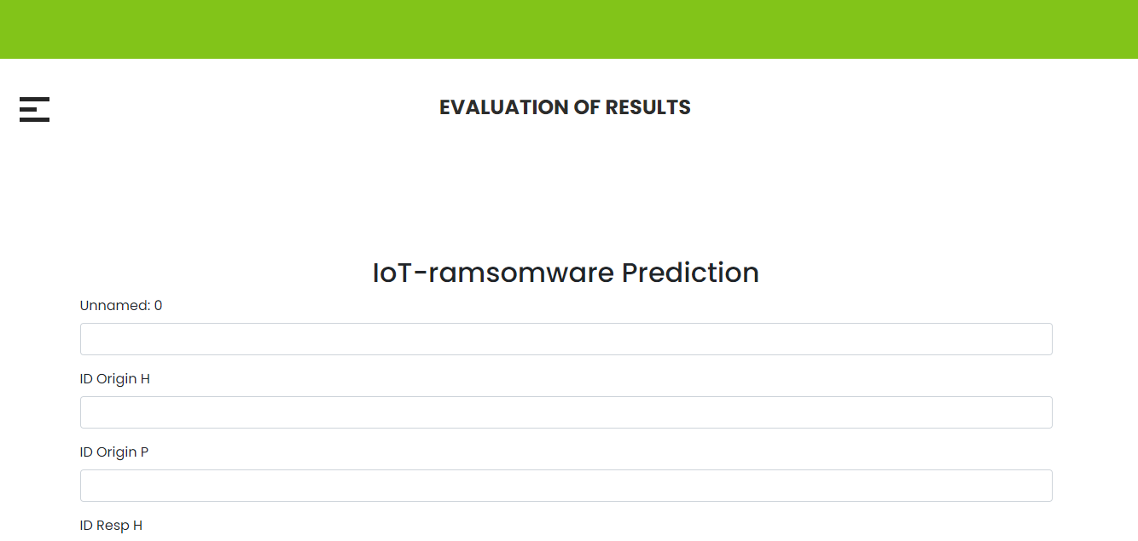
Prediction: This is the prediction page here user have to provide values of a 20 features and our model is predict the final output.

Slide 57
Future Scope
While the proposed framework for early-stage ransomware detection provides a robust mechanism for identifying potential threats, there are several avenues for future enhancement. One potential direction is the incorporation of more advanced machine learning techniques, such as deep learning models, to further improve detection accuracy and the system's ability to adapt to new ransomware strains. Additionally, the integration of threat intelligence feeds and collaboration with global cybersecurity networks could enhance the model's ability to identify emerging ransomware trends and patterns in real-time. Another area for improvement is the incorporation of cloud-based monitoring to extend the system’s capabilities beyond local networks, allowing for broader surveillance across hybrid environments. To address the challenge of minimizing false positives, the framework could be refined using advanced anomaly detection techniques, such as unsupervised learning methods or reinforcement learning, to better differentiate between normal behavior and potential threats. Furthermore, the system could be enhanced by incorporating real-time automated response mechanisms, such as self-healing systems that isolate compromised devices or applications, thereby further reducing the risk of ransomware spread. Finally, evaluating the framework's performance on diverse organizational infrastructures and deploying it in real-world scenarios will provide valuable insights into its scalability and effectiveness, leading to continuous improvements in ransomware detection and prevention strategies.

Slide 58
Conclusion
The rapid evolution of ransomware attacks necessitates the development of more adaptive and intelligent detection systems to counteract the growing threat. In this paper, we proposed an adaptive monitoring framework that combines behavioral analysis and network traffic examination for early-stage ransomware detection. By leveraging machine learning algorithms and real-time monitoring techniques, the system is capable of identifying anomalies associated with ransomware activities, such as unusual file access patterns, encryption behaviors, and irregular network traffic. The integration of adaptive models allows the system to evolve alongside emerging ransomware strains, minimizing the risk of false positives and improving overall detection accuracy. The experimental results show that this framework can successfully detect ransomware at its early stages, enabling timely mitigation actions and enhancing cybersecurity measures. This approach represents a significant advancement over traditional signature-based detection systems and offers a scalable solution to safeguard against a wide range of ransomware attacks. By combining multiple detection layers, our system provides a robust defense that can effectively reduce the impact of ransomware and protect critical organizational assets from potential damage.

Slide 59
REFERENCES
[1] W. Gong, Y. Zha, and J. Tang, “Ransomware detection and classification using generative adversarial networks with dynamic weight adaptation,” 2024.
[2] W. Koyirar, B. Harris, J. Williams, A. Moreno, and E. Davis, “Efficient ransomware detection through process memory analysis in operating systems,” 2024.
[3] J. Axali, L. Devereaux, A. Spencer, and F. Vasilev, “A multicriteria decision-making approach for ransomware detection using mitre att&ck mitigation strategy,” 2024.
[4] H. Kowalczyk, P. Zieli’nski, and A. Nowak, “Dissecting macos ransomware: A comparative analysis and mitigation strategies,” 2024.
[5] Y. Brinkley, D. Thompson, and N. Simmons, “Machine learning-based intrusion detection for zero-day ransomware in unseen data,” 2024.
[6] O. Viddiu, G. Macpherson, E. Vasquez, I. Kamenova, and D. Calderon, “Automated ransomware detection using windows file system activity monitoring and a novel machine learning approach,” 2024. [7] J. Long and H. Liang, “Ranaway: A novel ransomware-resilient refs file system,” 2024.

Slide 60
[8] W. Labone, N. Brown, S. Bellini, C. Williams, T. Flores, and P. Johansson, “Unidirectional and bidirectional machine learning models for ransomware detection via malicious opcode discovery,” 2024. [9] T. McIntosh, A. Kayes, Y.-P. P. Chen, A. Ng, and P. Watters, “Applying staged event-driven access control to combat ransomware,” 2023.
[10] A. Olsson and D. Andersson, “The dark flows of cryptocurrency: an overview of money flow behaviors in bitcoin transactions related to online criminal activities and bitcoin mixers,” 2024.
[11] R. Jones and H. Davies, “High-performance digital forensic framework for anomalous ransomware detection in file system log data,” 2024.
[12] Y. Zhang and Z. Huang, “Unveiling hidden patterns: A computational analysis of less commonly labeled ransomware families,” 2024.
[13] M. Argene, C. Ravenscroft, and I. Kingswell, “Ransomware detection via cosine similarity-based machine learning on bytecode representations,” 2024.
[14] J. Rafapa and A. Konokix, “Ransomware detection using aggregated random forest technique with recent variants,” 2024. [20] A. Panaras, B. Silverstein, and S. Edwards, “Automated cooperative clustering for proactive ransomware detection and mitigation using machine learning,” 2024.
[15] J. Chen and G. Zhang, “Detecting stealthy ransomware in ipfs networks using machine learning,” 2024.

Slide 61
THANK YOU
[16] E. Gupret, A. Turner, C. Evans, R. Morgan, and M. Richardson, “Duallayer ransomware classification using opcode and network traffic similarity,” 2024.
[17] S. Wang, Y. Li, and F. Chen, “Optimizing blue team strategies with reinforcement learning for enhanced ransomware defense simulations,” 2024.
[18] M. Ozturk, B. Yilmaz, Z. Arslan, and A. Demirbas, “An effective strategy for ransomware mitigation on android devices via android os file system api,” 2024.
[19] S. Liu and X. Chen, “Applying moving target defense against data theft ransomware on windows os,” 2023.
[20] I. M. El Emary and K. A. Yaghi, “Machine learning classifier algorithms for ransomware lockbit prediction,” 2024.

